Slide 1
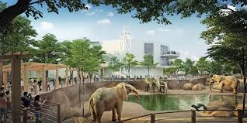
Athens Zoo Database
By: Logan Dwyer, Shritha Gorla, Ella Ramsell, Matthew Robertson

Slide 2
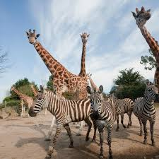
Context
The database is designed for a zoo management system. It manages various aspects of zoo operations, including events, employee records, resident animals, veterinary needs, food sourcing, ticket sales, and financial tracking. The database aims to streamline operations, enhance record-keeping, and provide insights for efficient management.

Slide 3
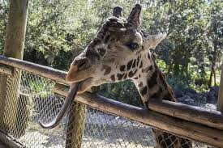
Nature of Business
The database is designed for a zoo management system. The zoo operates as an organization responsible for the care, exhibition, and conservation of animals, while also engaging in public education, entertainment, and research.
The business involves:
Animal care and welfare: Managing enclosures, food supply, medical treatments, and veterinary procedures.
Visitor engagement and revenue generation: Organizing zoo events, selling tickets, and tracking financial performance.
Operational management: Handling employee assignments, purchasing food for animals, and maintaining financial records for budgeting and sustainability.
This system ensures efficient management of the zoo’s daily operations, helping track animal health, employee responsibilities, food logistics, and financial performance, ultimately enhancing visitor experience and zoo sustainability.

Slide 4
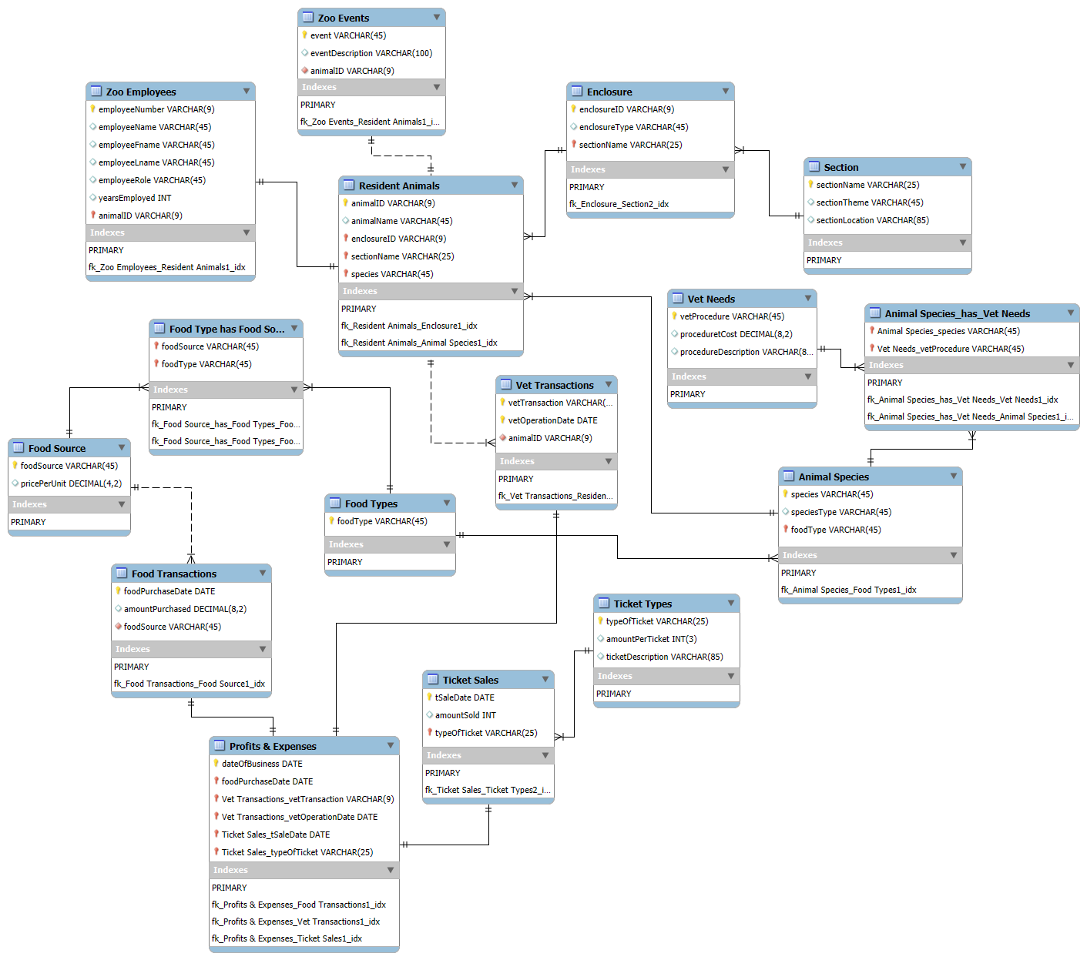

Slide 5
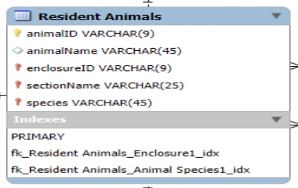
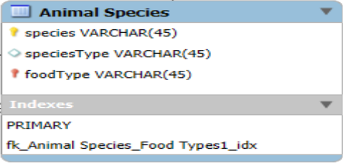
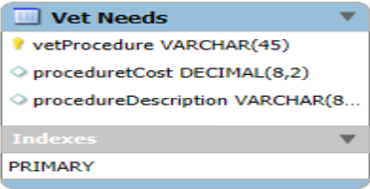
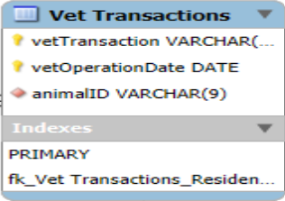
Entities and Relationship
Resident Animals: Central entity capturing animal details, linked to:
"Animal Species" for species-specific data.
"Vet Transactions" for veterinary care records.
"Zoo Events" for event participation.
"Enclosure" for housing details.
Animal Species: Defines species attributes and links to "Vet Needs" for specific medical procedures.
Vet Needs and Vet Transactions: "Vet Needs" defines medical procedures, and "Vet Transactions" records when these procedures occur.

Slide 6
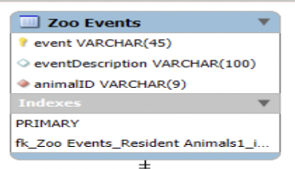
Entities and Relationship Cont.
Enclosure: Details about the animal's habitat, linked to "Section" to categorize zoo areas.
Section: Denotes the wider sections of the zoo, describing both the geographic locations within the zoo and its broader theme.
Zoo Events: Captures events held in the zoo. Related to "Resident Animals" through the animal ID, indicating which animals participate in events.

Slide 7
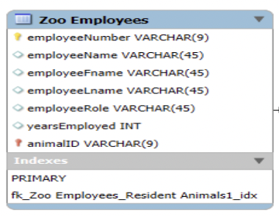
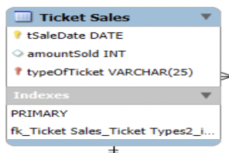
Entities and Relationship Cont.
Zoo Employees: Stores employee details, linking to "Resident Animals" to show assigned caretakers.
Ticket Sales: Manages sales data, linking to "Ticket Types" for pricing and descriptions.

Slide 8
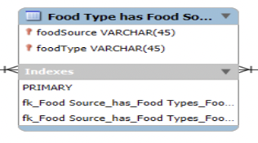
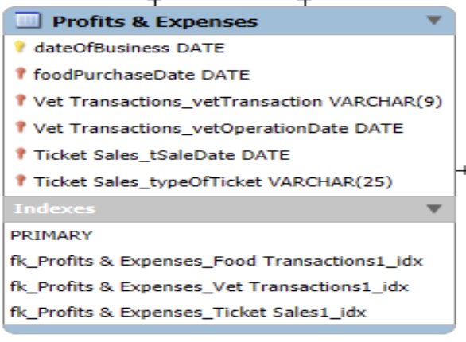
Entities and Relationship Cont.
Food Management: Entities like "Food Source," "Food Type," and "Food Transactions" track food purchasing and usage.
Profits & Expenses: Aggregates financial data from various transactions, including vet and food costs, to provide insights into zoo profitability.

Slide 9
Relationships
One-to-Many (1:N):
Each "Enclosure" houses multiple "Resident Animals."
A “Section” includes multiple “Enclosures.”
Many-to-Many (M:N):
"Animal Species" has multiple "Vet Needs," and each "Vet Need" can apply to multiple species.
One-to-One (1:1):
Each “Zoo Employee” cares for one “Resident Animal.”

Slide 10
Attributes
Attributes like "foodSource" and "vetProcedureCost" are specific to their entities, ensuring relevant data organization.
Financial data is centralized in "Profits & Expenses" for streamlined reporting.

